Slide 1
Introduction to Statistics

Slide 2
Definitions
Population - the entire group of individuals that we want information about
Sample – the part of the population that we actually examine in order to gather data
Statistic – a measure describing the sample
Sampling error

Slide 3
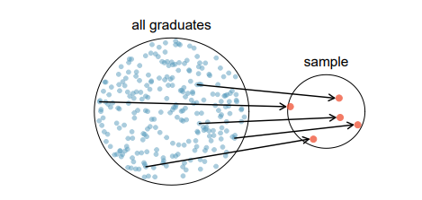
Types of Sampling
1. Simple random sampling – Each individual in a population has an equal chance to be selected.

Slide 4
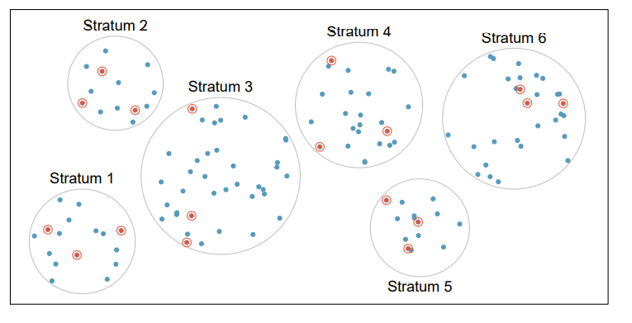
2. Stratified – The population is divided into groups of common characteristics, and a random sample chosen from each group.

Slide 5
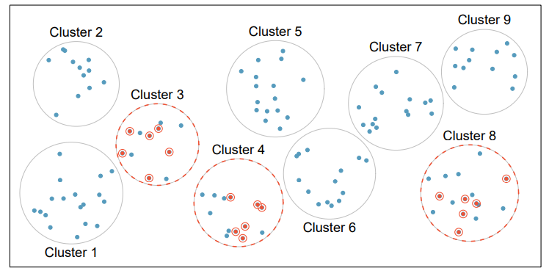
3. Cluster – The population is divided into clusters and then certain clusters are chosen at random.

Slide 6
Sampling Distribution
The distribution of the values of the statistic in all samples of the same size from the same population
Improved by taking many samples
Improved by increasing the size of the sample

Slide 7
Variables
Qualitative – categorical
Ordinal – Data in a rank, in an order
Nominal - Random
Quantitative – numerical, showing order and amount
Continuous – Numbers fit on a scale
Discrete – Individual numbers, counts

Slide 8
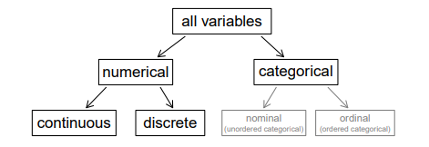

Slide 9
Example
Data were collected about students in a statistics course. Three variables were recorded for each student: number of siblings, student height, and whether the student had previously taken a statistics course.
Classify each of the variables as continuous numerical, discrete numerical, nominal categorical or ordinal categorical.

Slide 10
Explanatory Variable – the variable that can be altered or manipulated in research Response Variable – the result of the manipulation done to the variables

Slide 11
Example In questions that involve weight and height, height is likely to be the explanatory or response variable?

Slide 12
Statistics
Descriptive – collecting and displaying data
Inferential – collecting sample data in order to make statements about a population

